Slide 1
School Gradebook Website
Darren Wong, Dominic Pham, Thien Tran

Slide 2
Overview
Our project allows students and teachers to log into a website to see their grades of the classes they are taking and allows teachers view student grades, also to prompt an error message if their login ID is wrong.

Slide 3
Current vs. Legacy Systems
The legacy of the SJSU grade reporting system is not unified. Some teachers use other sites and canvas, having the students check multiple places to see their grade. The current system is all in one place making it easier for students and teachers to see grades.

Slide 4
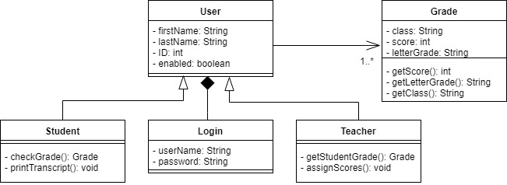
Class Diagram

Slide 5
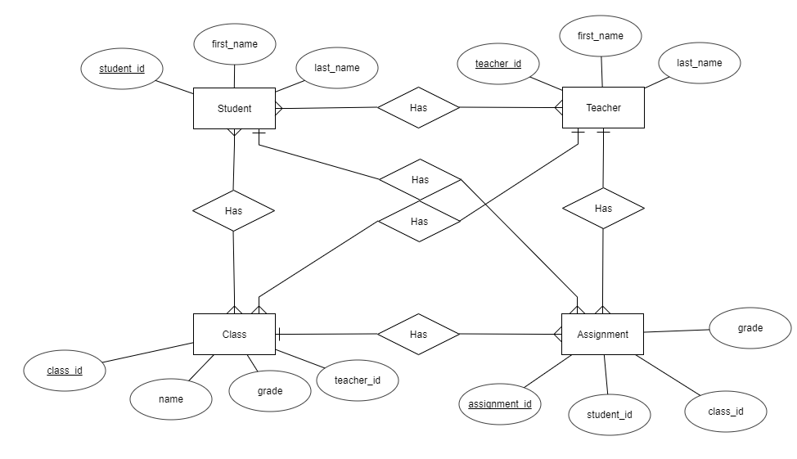
ERD Diagram

Slide 6
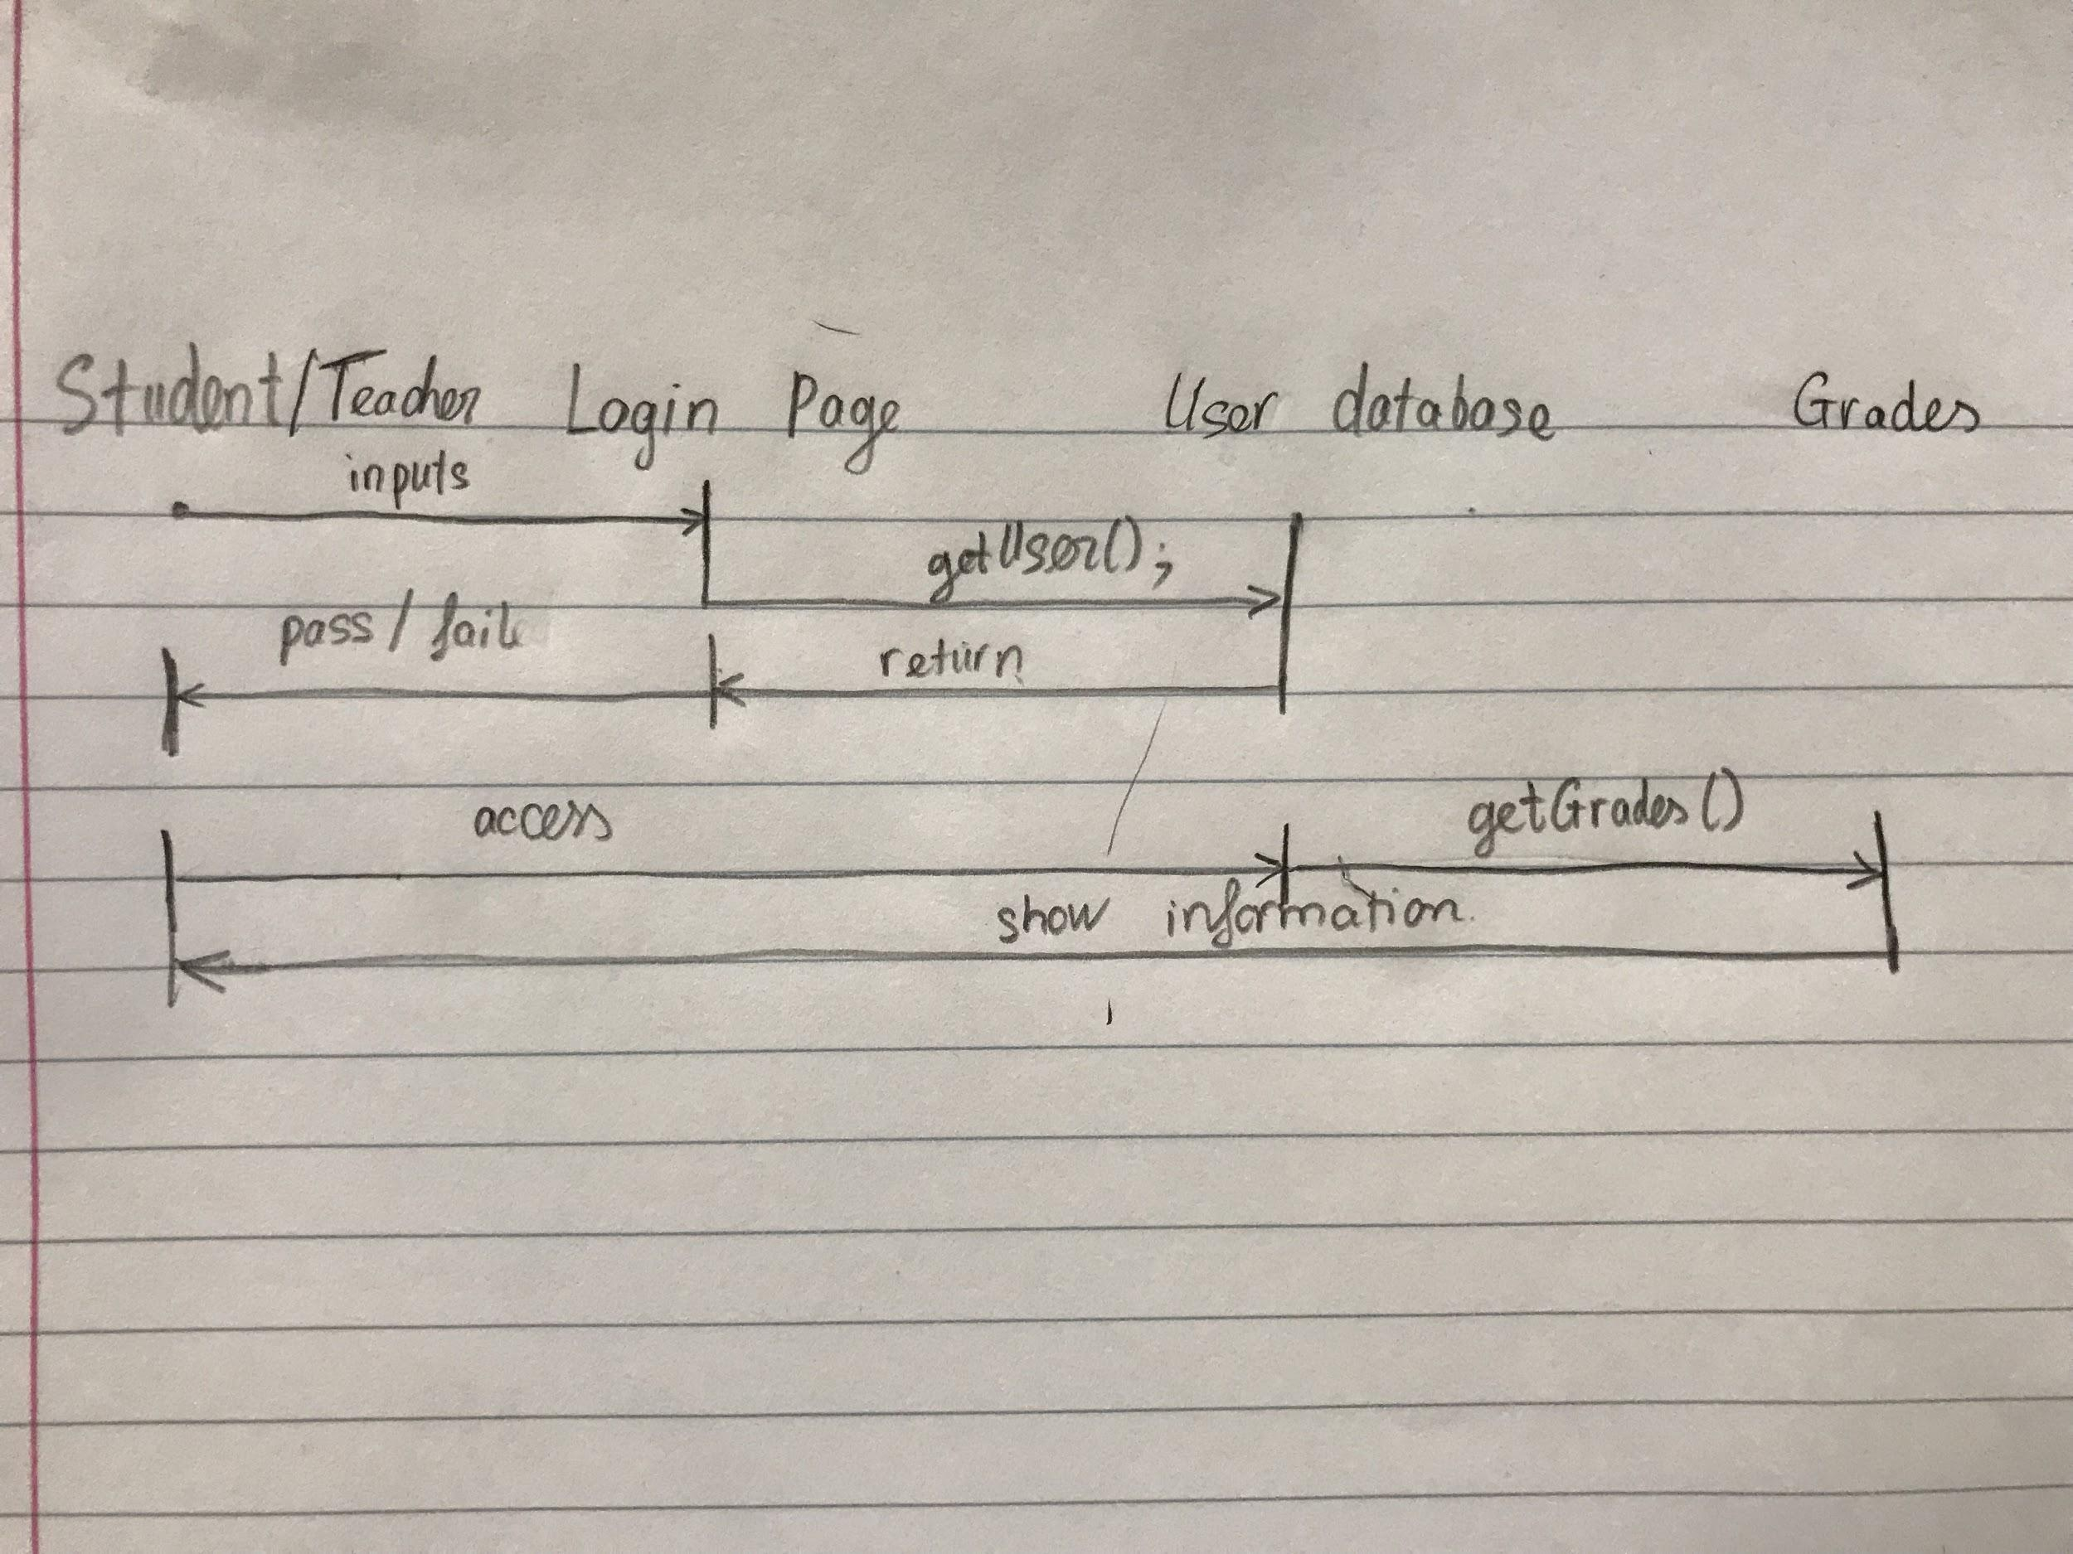
Sequence Diagram

Slide 7
Relational

Slide 8
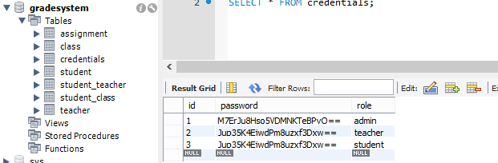
Screen shot

Slide 9
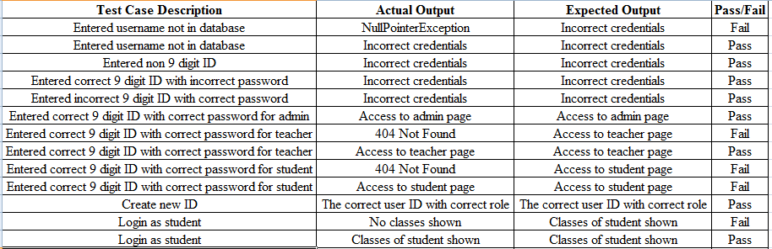
Test Case Diagram
Notes:
For the first test case: Fixed by checking if data is null
(Test #7 404 Not Found) 2nd & 3rd: Misspelled class names; fixed by correcting spelling
(Last Case) 4th: Fixed by correcting SQL query

Slide 10
Functional requirements
Web application will have a login page
Students only have access to their own grades
Will prompt an error message if person enters wrong credentials
Admin should be able to create new IDs
Each student or teacher will be uniquely identified by their 9-digit ID
Teachers have access to grades of students in their class

